Slide 1



STUDENTS PERFORMANCE ANALYSIS
Insights from Python Data Analysis
By - Geofrey

Slide 2

Introduction
This presentation explores student performance data to uncover key patterns and insights.
We will:
Analyze the impact of factors like gender, race, and parental education on academic scores.
Examine how test preparation and lunch type influence performance.
Build and evaluate a predictive model to estimate student scores.

Slide 3
File: StudentsPerformance.csv
Records: 1,000
Features: 8 (e.g., Gender, Race, Parental Education, Lunch, Test Preparation)
Data Overview

Slide 4

Findings

Slide 5
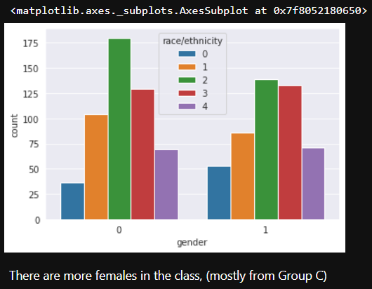
Analysing Gender & Race
There are more females in the class, (mostly from Group C)

Slide 6
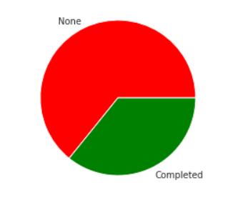
Analysing Test Preparation Course

Slide 7
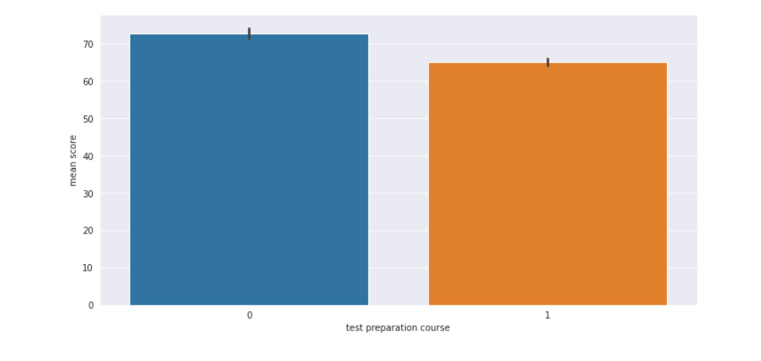
Analysing Test Preparation Course
The students who have completed Preparation Course are scoring good scores

Slide 8
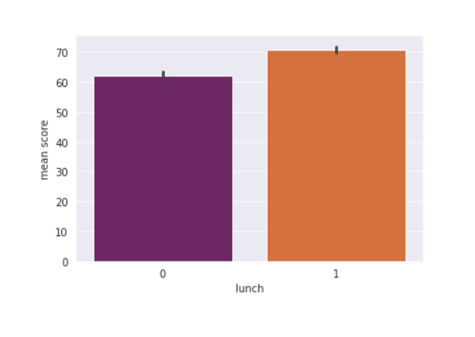
Analysing Lunch
The students who get standard lunch are performing better in exams than the students with free/reduced lunch

Slide 9
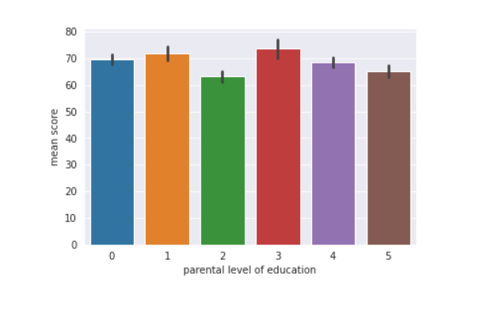
Analysing parental level of education
2nd Category of Parental Education belongs to High School and 3rd Category belongs to Master Degree therefore Parents Education is directly proportional to Students Marks

Slide 10
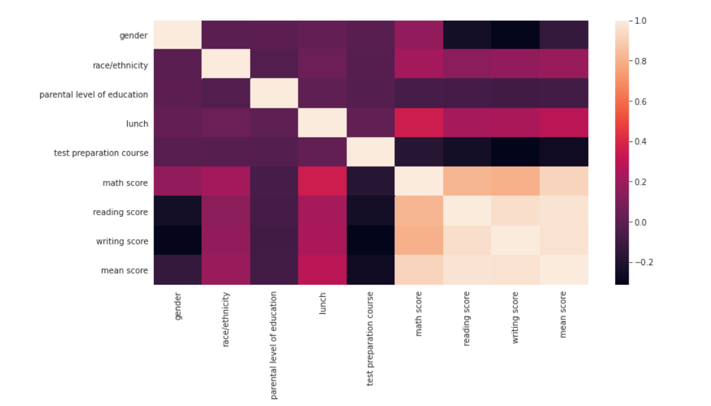
HEAT MAP

Slide 11




Thank's For Watching
Connect @
9751323087
geo7409@gmail.com

